Slide 1
CharityGuard
A Decentralized Charity Donation Platform
ABB Muhaimeen BSSE-1423
Md. Tamim Hasan Toha BSSE-1424
Supervised by
Dr. Shafiul Alam Khan
Professor
IIT, DU

Slide 2
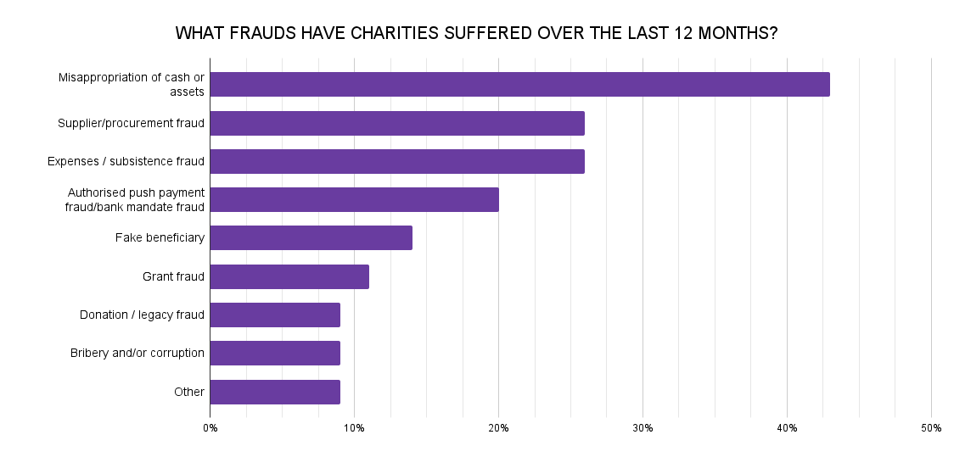
The problem
Conventional donations are increasingly vulnerable to fraud, including fund misappropriation, unauthorized payments. Without secure systems, both donors and charities risk losing trust and funds.

Slide 3
Motivation
By developing this platform, we aim to promote trust, accountability, and efficiency in the charity ecosystem, potentially reshaping how donations are managed globally.

Slide 4
Project Description
This project aims to develop a decentralized charity donation platform using web3 technology to enhance transparency, security, and accountability in charitable transactions.
Normal Requirements:
User Interface: Users can create accounts, browse charitable campaigns, and donate.
Charity Campaigns: Charities can launch campaigns specifying their goals and deadlines.

Slide 5
Project Description(Contd.)
Normal Requirements:
Smart Contracts for Donation Management: Automates fund transfer to the campaigns based on predefined conditions (e.g., campaign reaching target).
Transparency and Tracking: Blockchain will ensure an immutable ledger of donations, allowing donors to track how their contributions are used.

Slide 6
Project Description(Contd.)
Exciting Requirements:
Governance Mechanism: Community-driven decision-making for selecting campaigns or managing disputes via voting.
Islamic Donation Estimation and Assurance: Calculate the Zakat of the Islamic User and ensure the proper channel to donate Zakat.
Generate reports(e.g. audit) as per the operational context.

Slide 7
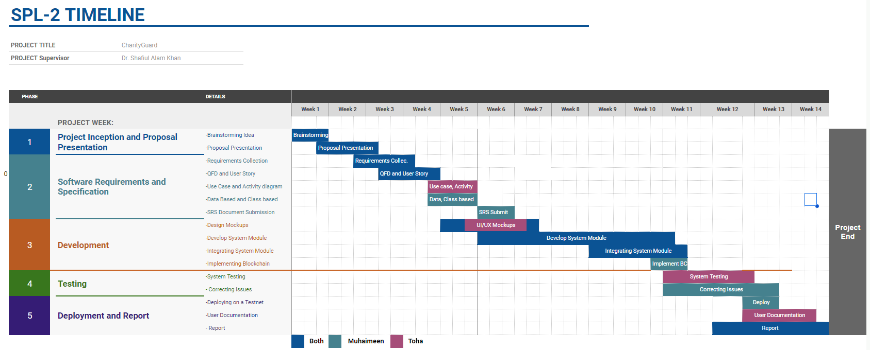
10.13.XX
11.1.XX

Slide 8
Technological Tools
JS Frameworks
Solidity
Ethereum
Git

Slide 9
Thank
You

